Slide 1

Practice Your Programming with Katas
Session 5: E₁X₈P₄E₁D₃I₁A₁

Slide 2

Week 5: http://eca-katas/session5
Write a function that verifies if a word played in scrabble is valid.
Simplified Rules:
Each player has 7 tiles, which each depict a letter
Each letter is worth a set number of points, add the value of each letter in a word together to get its score
If all 7 tiles are played, an extra 50 bonus points are awarded
All words played must be in the dictionary, and no more than 7 letters
Words should not be punctuated
We’re assuming that no words already exist on the board, and there are no blank tiles or special squares.
Your function should return the score for the word, or 0 if it’s not a valid word

Slide 3
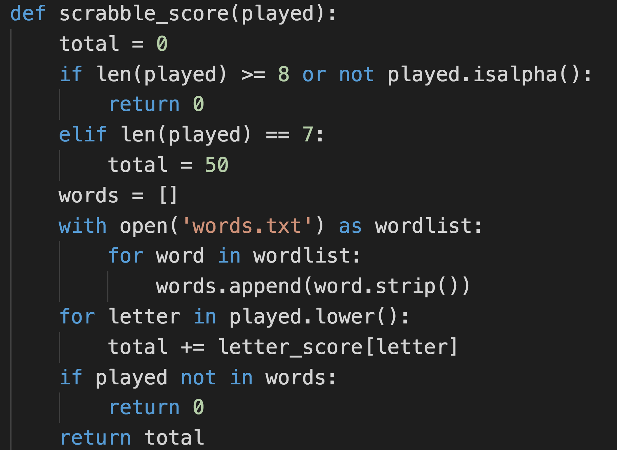
A B₃A₁S₁I₁C₃ Solution

Slide 4
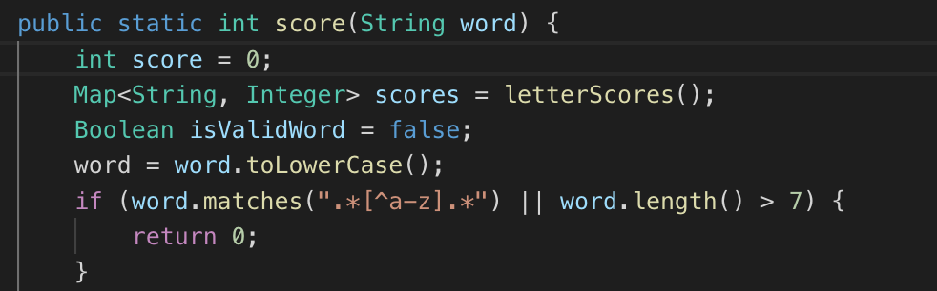
Java-flavoured basic solution

Slide 5
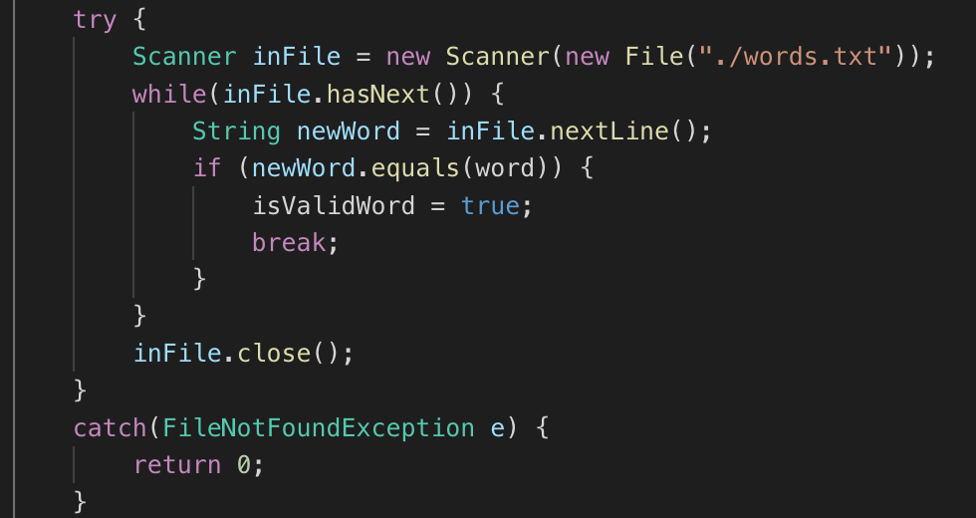
Java-flavoured basic solution, continued

Slide 6
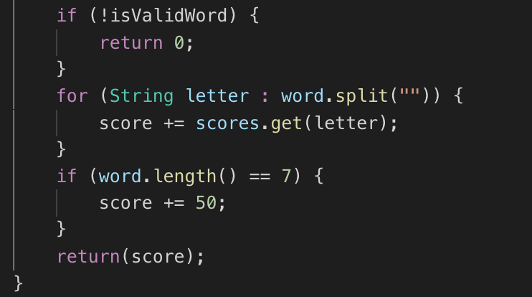
Java-flavoured basic solution, further continued

Slide 7
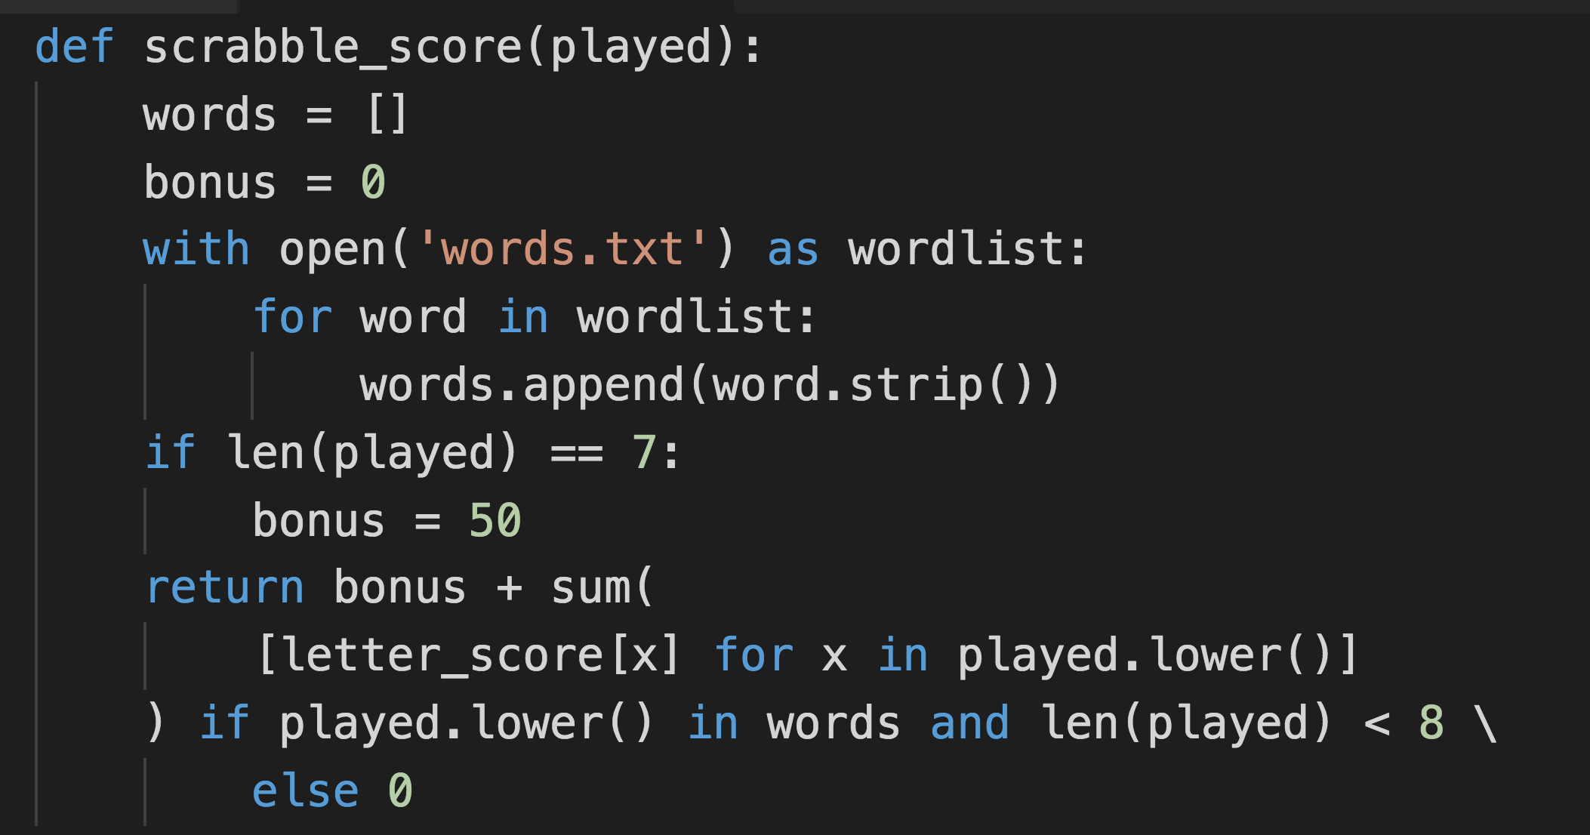
Starting to use List Comprehensions

Slide 8
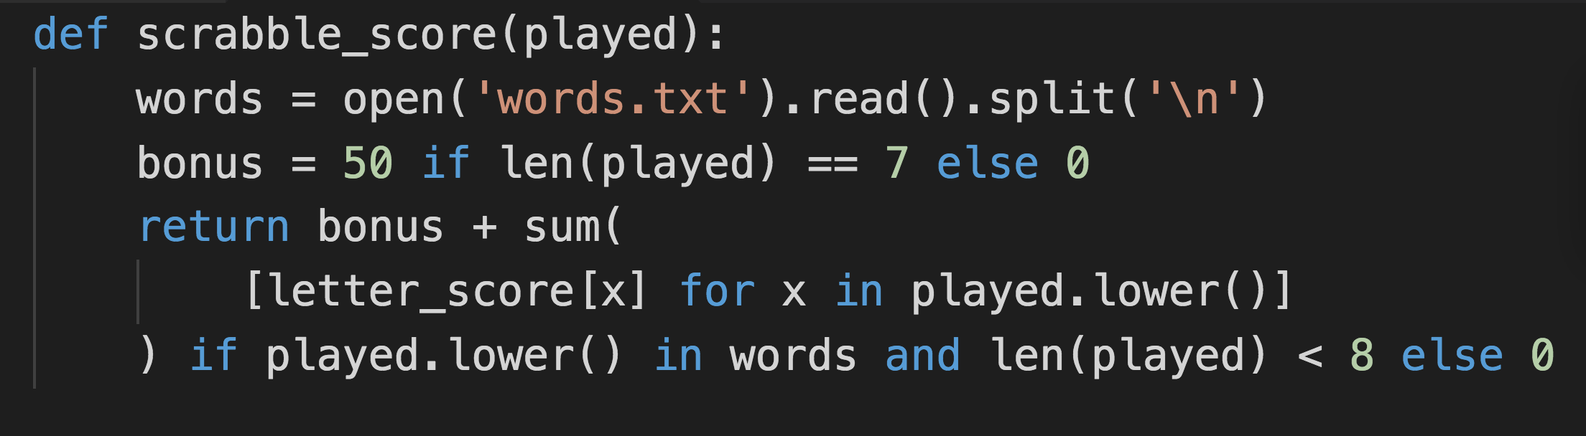
One line to read them all
Notes:
Slightly naughty in that I’m relying on the compiler to close my file for me.

Slide 9
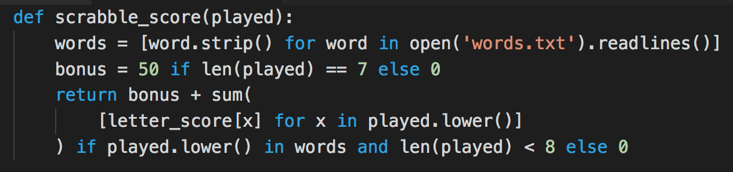
More List Comprehensions

Slide 10
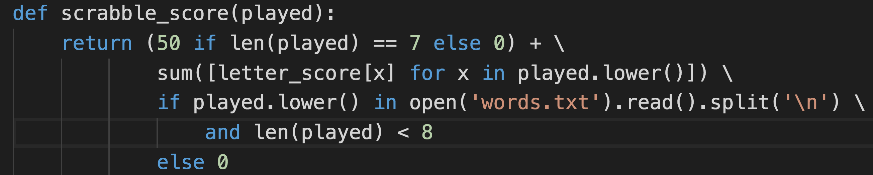
Lesser-Spotted Nested Ternary Operator

Slide 11
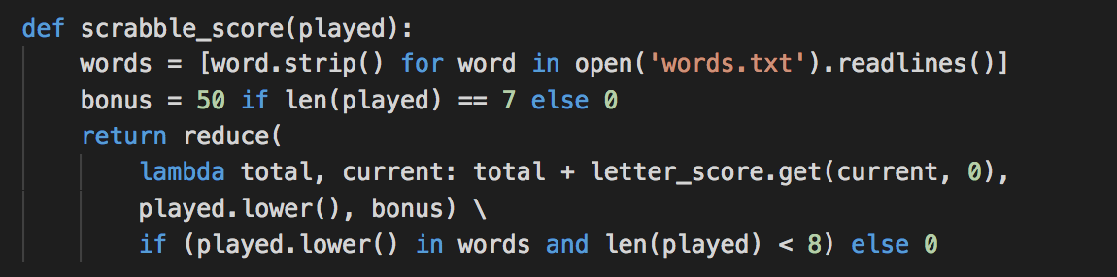
reduce() is an option, too!
Python 3’s reduce is part of functools.
Reason: it’s deemed to be so confusing it should almost never be used.

Slide 12
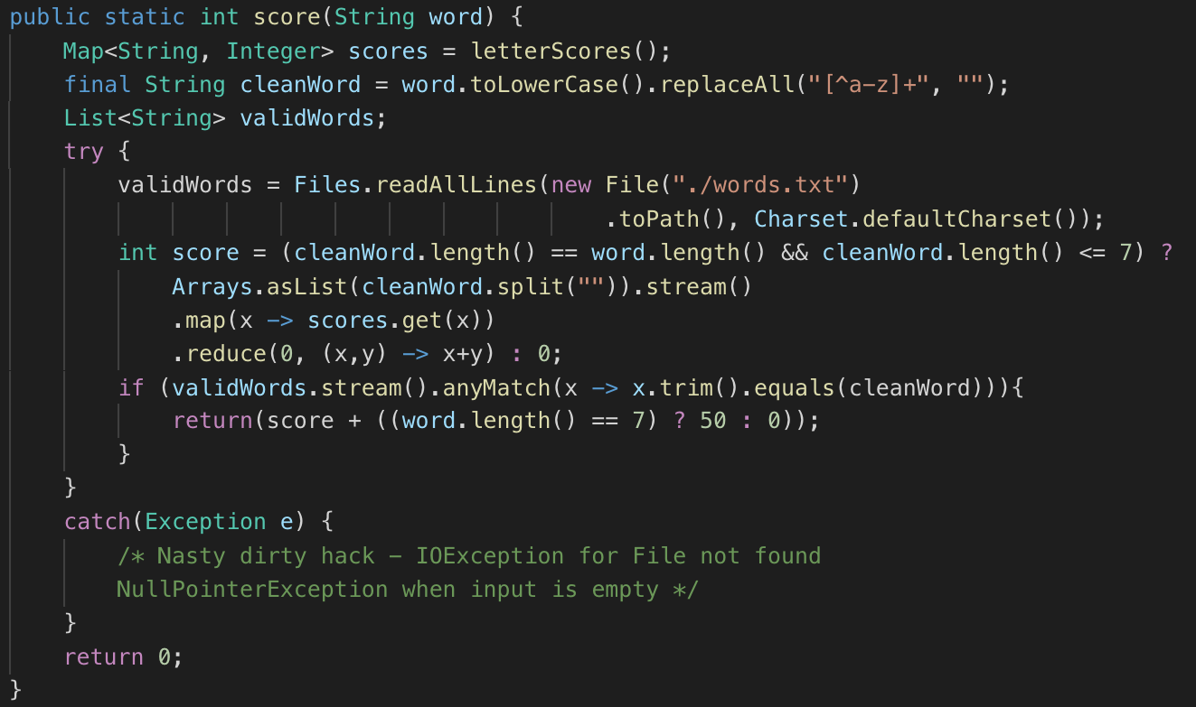
map().reduce() to get the score

